Slide 1
Travel Money Cards
DATABASE PROJECT
Travel the World with Ease!

Slide 2
1
Project Idea
My database stores data about travel money cards. A travel money card is similar to a debit card. It can be pre-loaded with one or many currencies.

Slide 3

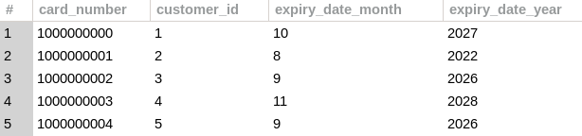
A travel money card has card number and expiry date, just like a debit or credit card.

Slide 4
2
Database Model
The main tables in my database are: Customers, Customer Addresses, Money Cards and Card Balances

Slide 5
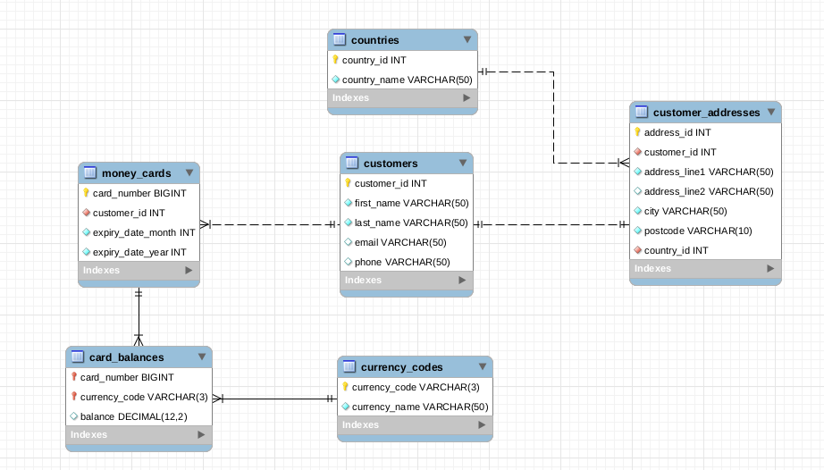

Slide 6
Dolor Sit
Tables
Customers Data
Money Cards
Card Balances
Customers table holds customer data such as first name, last name, email and phone.
A separate table is created to hold customer addresses, has columns for address, city, postcode and country.
Addresses table linked to customers table using customer_id
Money Cards table has card numbers and expiry month and year.
It’s linked to customers table using customer_id.
It’s one to many relationship, means one customer can have multiple cards.
Balances table has card balances for each purchased currency.
It’s linked to money cards table using card_number.
It’s one to many relationship means one card can hold multiple currencies at the same time.

Slide 7
There are two reference data tables; currencies and countries; to store list of available currencies to purchase and list of countries for customer addresses

Slide 8
3
Demo
Let’s have a look inside the money cards data and run some queries

Slide 9
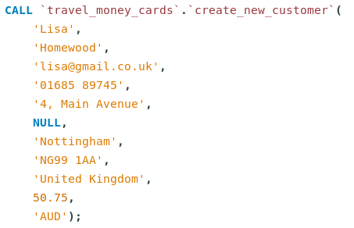
Demo 1
Create new customer
Create a new customer using the store procedure. The stored procedure will take care of adding into customer and addresses table. It will also create a default money card for the customer and load requested amount.
* Data selected using a view

Slide 10
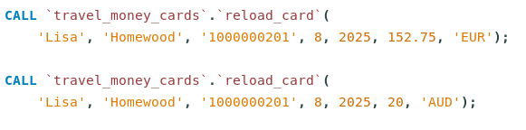
Demo 2
Reload currency
Reload currency into customer card using stored procedure. The stored procedure takes care of validating the card details and currency code.
* Data selected using a view

Slide 11




Demo 3
Sample Data

Slide 12


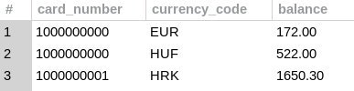
Demo 3 Cont...
Sample Data

Slide 13
4
Questions & Answers

Slide 14
THANK YOU

Slide 15
References
The project idea is from my day to day job. I am a Bureau Manager at ASDA Travel Money.
I used workbench and visual studio code to complete this project.
All the scripts used to create this project database are checked into git repository - https://github.com/navdeep-kaur-py/cfg-sql-project
I used w3schools.com, www.mysqltutorial.org and stackoverflow.com for learning and troubleshooting.
I used generatedata.com to generate random data to populate my tables.

